Slide 1



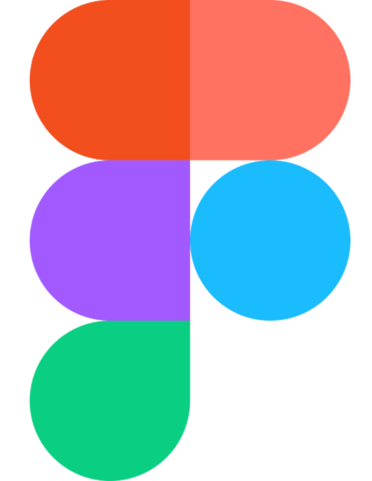









Development environment
Azure Cloud
Front-end
Back-end
Developer
Idealization
Azure Database SQL
Development
Building
Test
UI
Execution
Service Web app
End-User
Browser

